Slide 1
User Modelling
Revise your target market definition and classification
Build the following
  Class profiles
  Personae
  Scenarios (Storyboards)

Slide 2
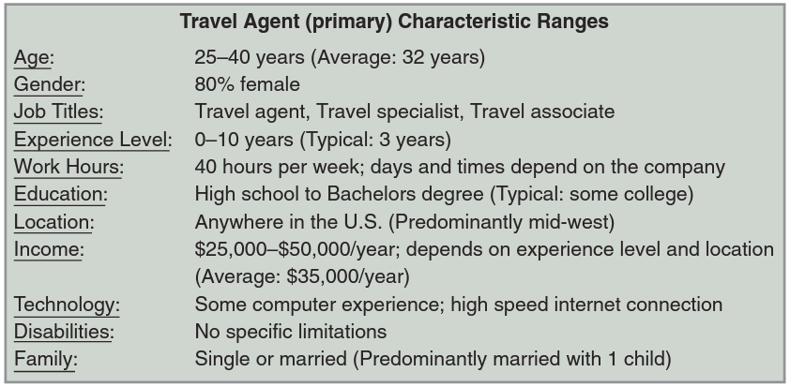
Class Profile: Travel Agent (Primary)

Slide 3
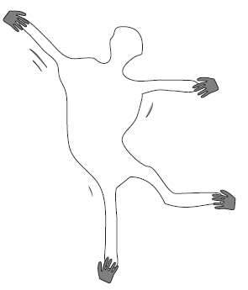
Personae
The non-Elastic User

Slide 4
Personas
At least One representative of each class
Notes:
2. Why do you need a persona?
Whether you’re developing a smartphone app or a mobile-responsive website, it’s very important to understand who will be using the product. In order to solve a real user problem, you need to have a clear problem statement in mind; in order to write this problem statement, you first need to understand your users and their needs

Slide 5
The Persona
Never refer to “the user”, instead refer to a very specific individual, a persona.
Take a class profile and then fill in details to create a “typical” user
  At least One representative of each class
From the insight you gained in your interviews, you now invent user archetypes to represent the main user groups of your product.
In other words, you make up pretend users and design for them.

Slide 6
The Persona
A persona is a prototypical user:
  An imaginary, but very specific, example of a particular type of user.
  Not “real”, but hypothetical.
A persona is used to role-play through an interface design and check if the design would meet the needs of such a user.
It is more important to define the persona in great and specific detail, so that it cannot wiggle under the pressure of development.

Slide 7
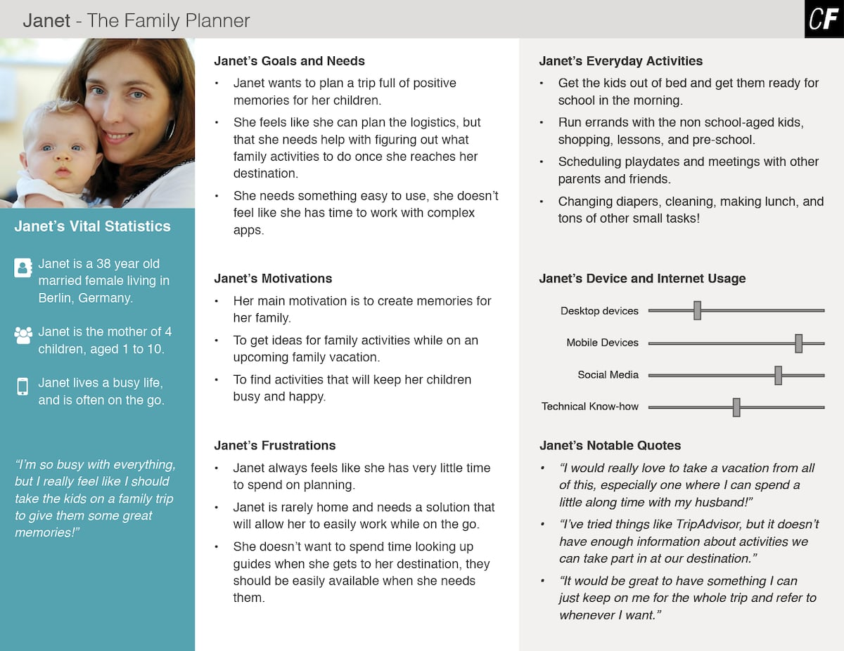

Slide 8
The Persona
A persona clarifies who is in your target audience by answering the following questions:
  What are the current behavior patterns of my users?
  What are the needs and goals of my users?
  What issues and pain-points do they currently face within the given context?

Slide 9
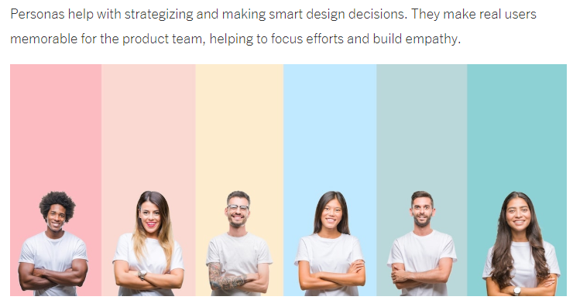

Slide 10
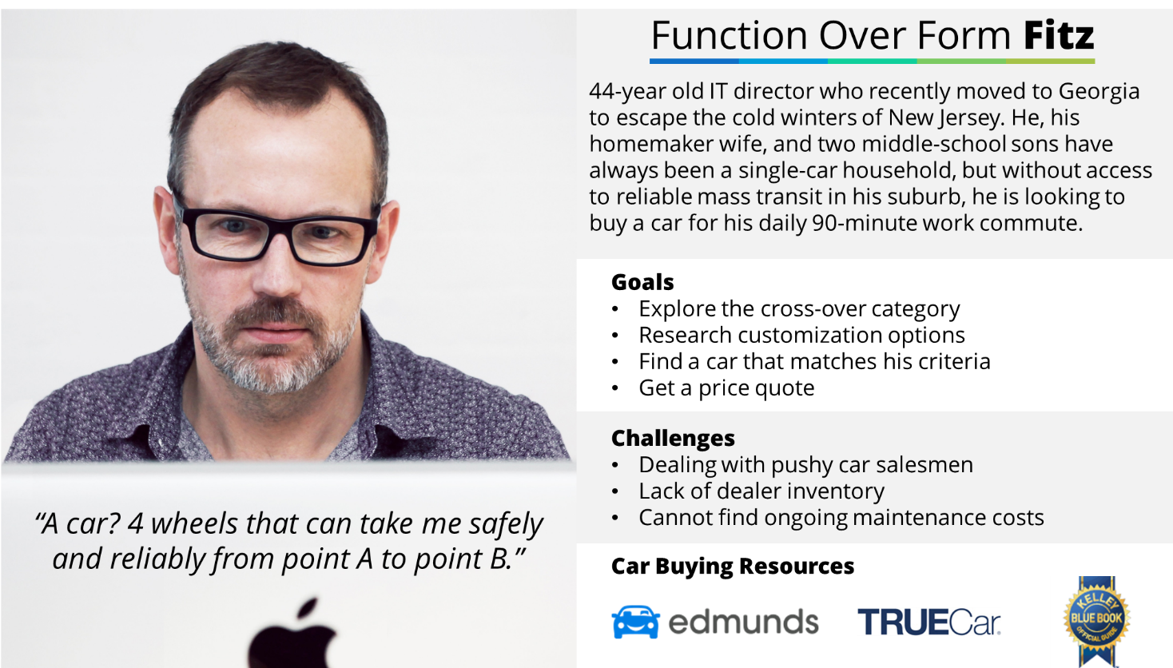

Slide 11
How Do You Define A User Persona?
Header
Demographic Profile
End Goal(s)
Let’s imagine you’re designing a travel app. The foundations of your user persona could look like this:

Slide 12
How Do You Define A User Persona?
Header
Name: Savannah Rodriguez
Summary quote: “Take me to undiscovered holiday destinations away from the tourist traps.”
This first step might seem simple, but these features ensure that your persona is memorable, keeping the design team focused on who they are designing for.

Slide 13
How Do You Define A User Persona?
2. Demographic Profile : based on user research.
personal background
  age, gender, ethnicity, education, persona group (e.g. working moms), and family status (e.g. single, married with children, widowed, etc.).
Example: Savannah, 52 years old, divorced mother of two, has a Master’s degree in chemistry.
Notes:
Creating a psychographic profile enables you to better understand why your user behaves in a certain way—including why they use your product.

Slide 14
How Do You Define A User Persona?
2. Demographic Profile : based on user research.
professional background
  job occupation, income level, and work experience
Savannah works full-time at a pharmaceuticals company and earns around $65,000 per year.
Notes:
Creating a psychographic profile enables you to better understand why your user behaves in a certain way—including why they use your product.

Slide 15
How Do You Define A User Persona?
2. Demographic Profile : based on user research.
user environment
  the physical, social, and technological context of the user. What technological devices do users have access to? Do they spend most of their time in a corporate office or a home office? And how often do they collaborate with others?
Savannah’s user environment could be in her office, mostly on a laptop, but also on her iPad when commuting to and from work.
Notes:
Creating a psychographic profile enables you to better understand why your user behaves in a certain way—including why they use your product.

Slide 16
How Do You Define A User Persona?
2. Demographic Profile : based on user research.
Psychographics
  attitudes, interests, motivations, and pain points
Savannah enjoys luxury spa retreats, hates tourist traps
Appreciates an element of exclusivity
Enjoys trying authentic local cuisine
Prefers to travel alone or with one other person
Tends to favor quality over economy
Notes:
Creating a psychographic profile enables you to better understand why your user behaves in a certain way—including why they use your product.

Slide 17
How Do You Define A User Persona?
3. End Goal(s)
Helps answer the question: what do users want or need to accomplish by using your product?
End goals are the main driving forces of your users and determine what the persona wants or needs to fulfill.
In Savannah’s case, her end goal when using your holiday-booking app is to discover and book luxurious, off-the-beaten-track holiday destinations.

Slide 18
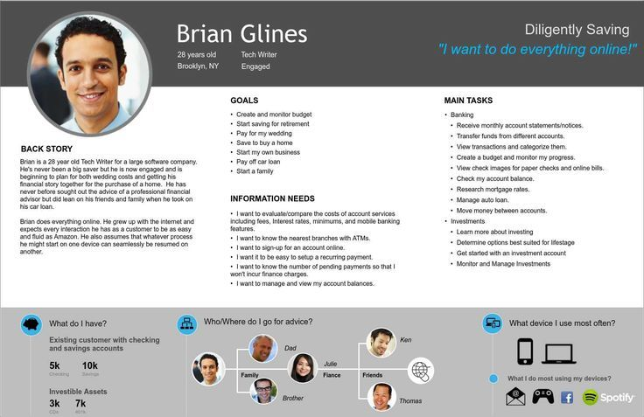

Slide 19
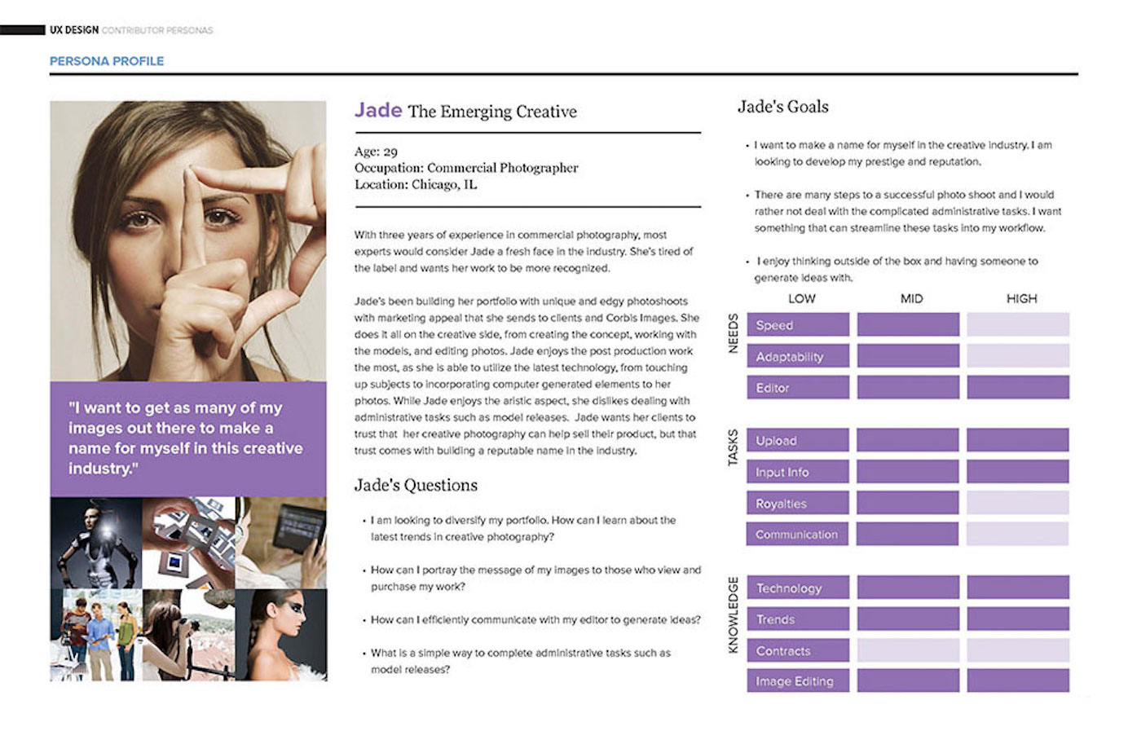

Slide 20
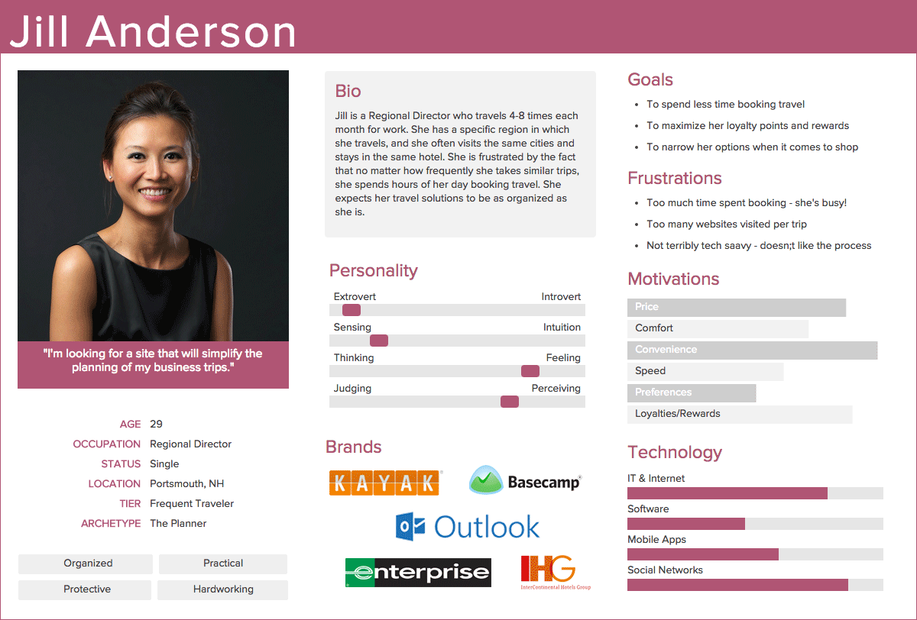

Slide 21
Resources
See “05-Ten Steps to Personas.pdf” on Portal
https://careerfoundry.com/en/blog/ux-design/how-to-define-a-user-persona/
https://www.smashingmagazine.com/2014/08/a-closer-look-at-personas-part-1/

Slide 22
Scenarios

Slide 23
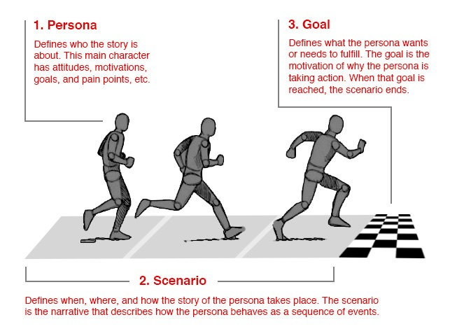
User Scenario
A precise description of a persona using an interface to achieve a goal

Slide 24
Creating Scenarios
Scenarios normally include descriptions about:
  The individual user (i.e., the persona)
  The task or situation
  The user’s desired outcome/goal for that task
  Procedure and task flow information
  Envisioned features/functionality the user will need/use.
Success and/or failure scenarios
  You may also want to include exceptions. What are some of the rare events that happen?

Slide 25
Sally plans her vacation
Sally needs to plan a vacation for her family. She decides to hop on TravelSmart.com and do both the research and reservations there. She begins by researching the top family-friendly destinations as recommended by TravelSmart.com customers. She wants to compare the travel time, travel costs, hotel costs, hotel availability, and amusement activities for each destination. For each of those criteria, Sally gave a weighting to help her make her decision. She finally settled on the destination that required the least travel time, cheapest travel costs, moderate hotel costs, good availability, and a large selection of activities for the whole family. From that spot, Sally begins searching for the flights and hotels that meet her criteria. She decides to save those results for later because she wants to be sure the whole family is in agreement before she makes the reservations with her credit card.
Notes:
Main contents
Persona context motivation end goal seq of steps

Slide 26
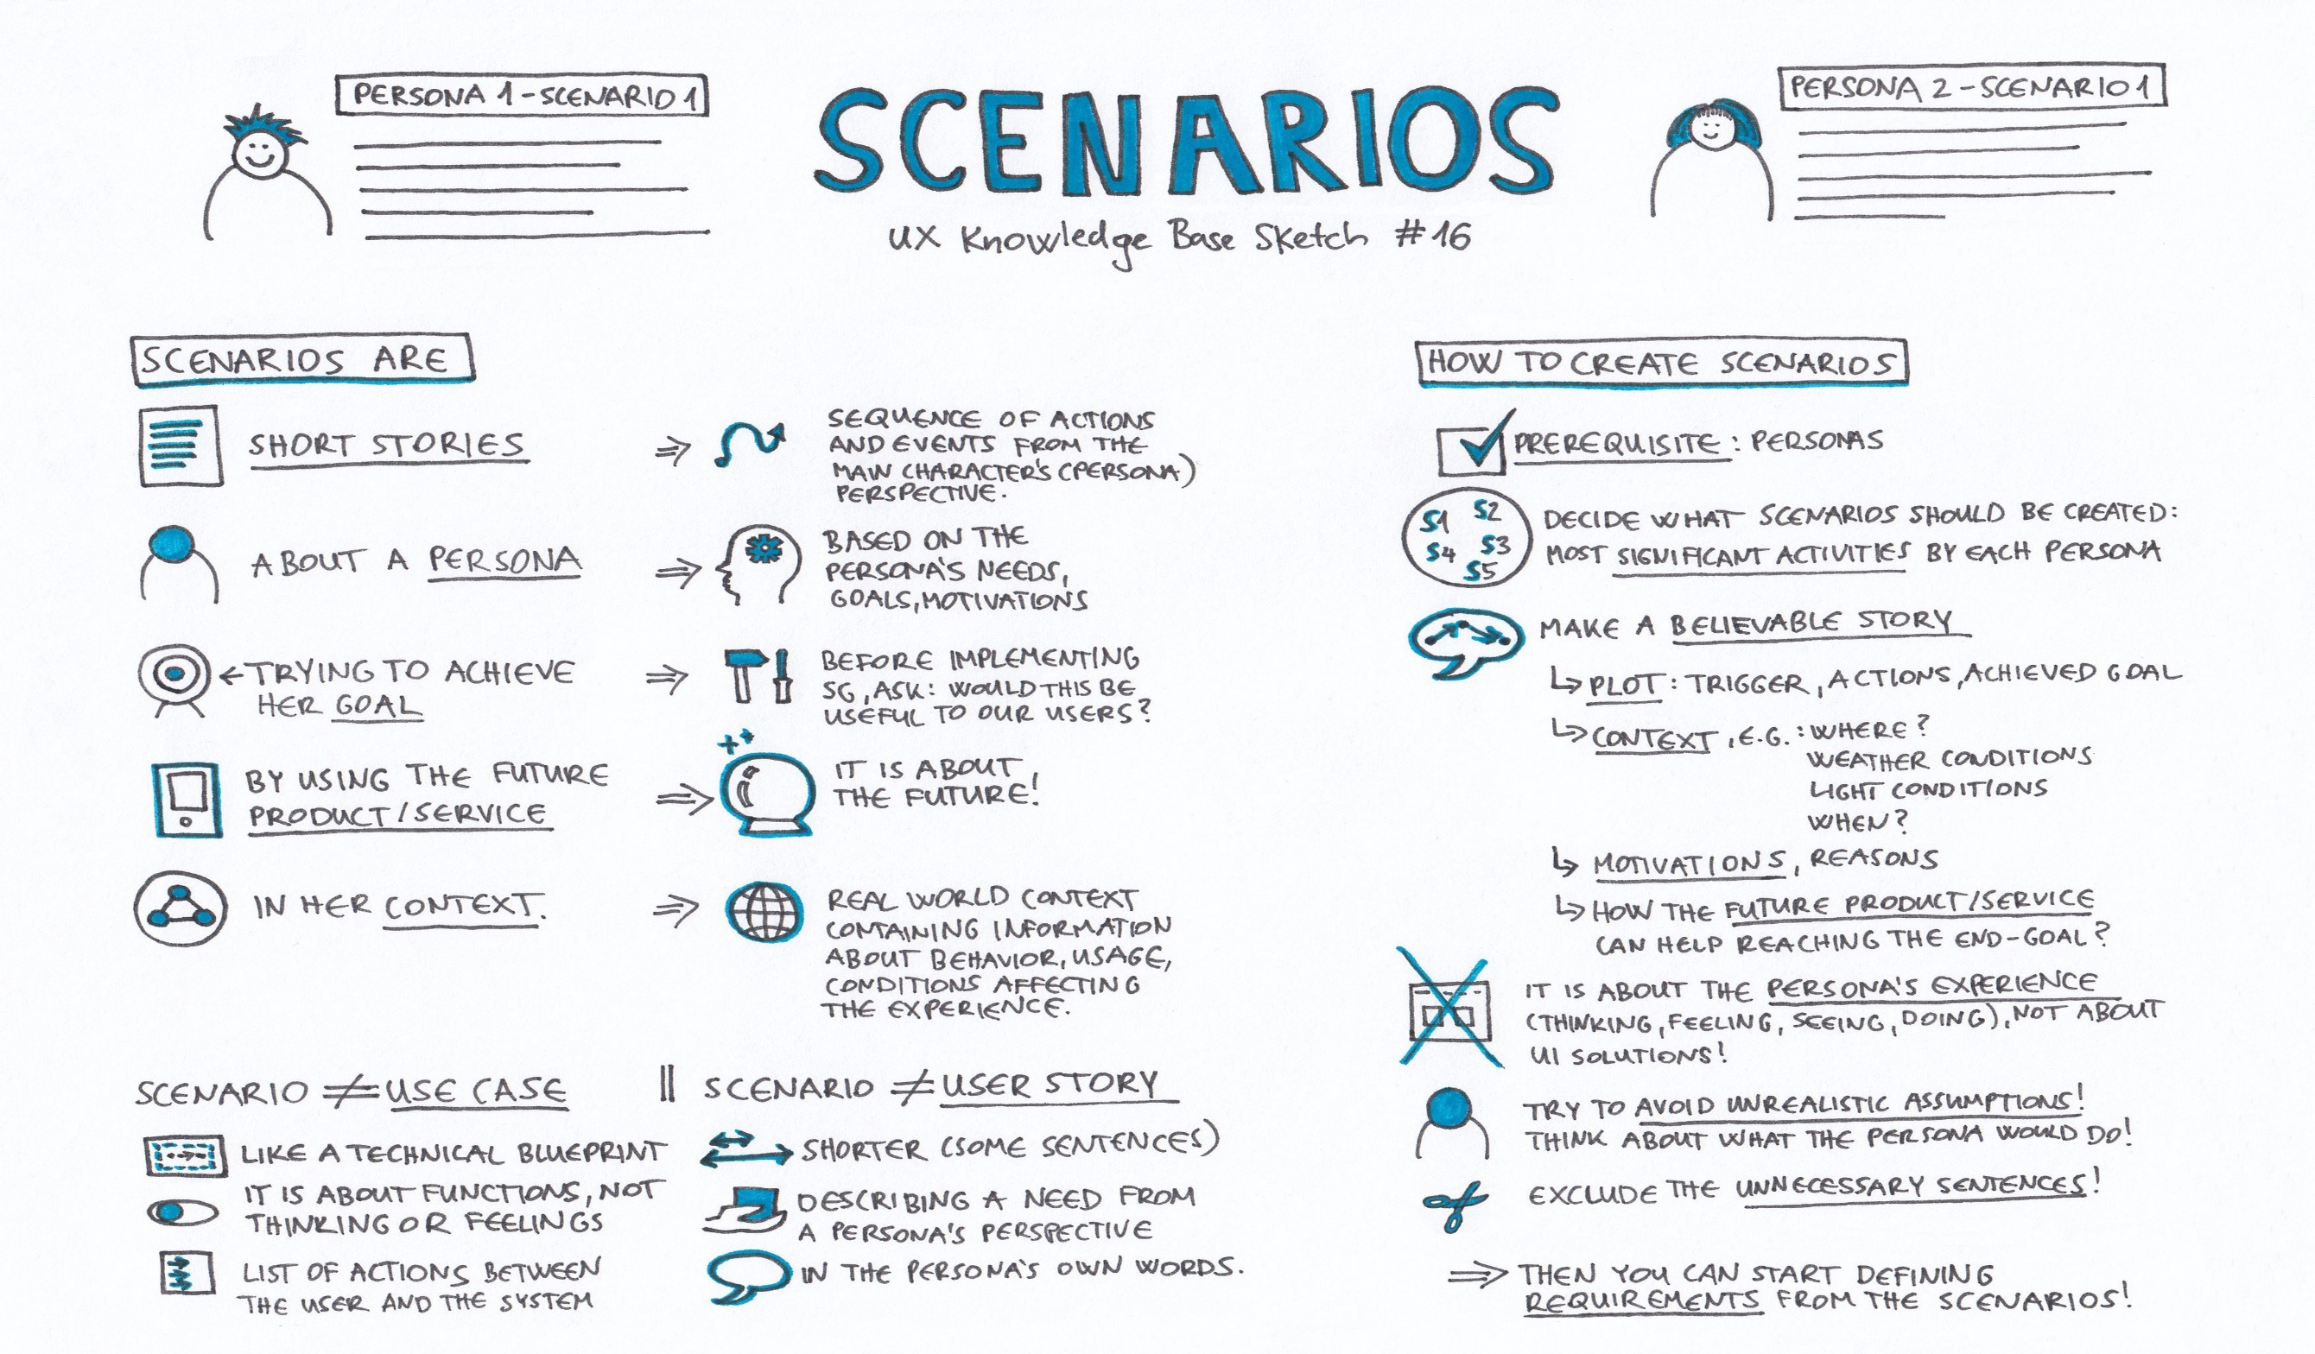
Notes:
For example, in our fictitious online library system, the functionality for managing returns would need to handle the separate situations where a borrower returns a book early and when he/she returns it late. Although the same functionality is involved, they are different situations and the system would need to handle the separate conditions in each use case. Therefore use-cases are a valuable way of uncovering implied functionality that occurs due to different ways in which the system will be used. Also use-cases provide a great starting point for the test cases that will be used to test the system.
These are similar to use cases in terms of what they seek to accomplish - a description of the how the system will carry out a specified business process to fulfill the stated requirements. However unlike a use case which is a step-by-step enumeration of the tasks carried out during a process (with the associated actors), a scenario is much more free-form.
A user story is typically a narrative that describes how a user would experience the functionality of the system. As the name suggests it is a "short story" that describes the tasks they carry out, what information they see and how they interact with the system.
A perfect user scenario comes in a way of a short story that clearly defines the context in which the product is used. It gives answers to such important questions as: Who is the user of our product? What does this user want to accomplish with our product? How is this user going to achieve her goals? Why does this user choose our product over other available options?

Slide 27
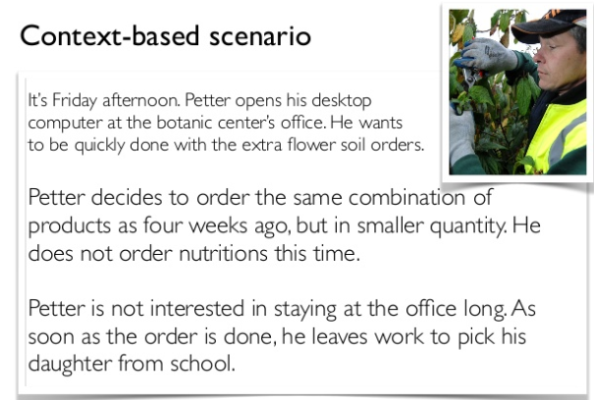

Slide 28
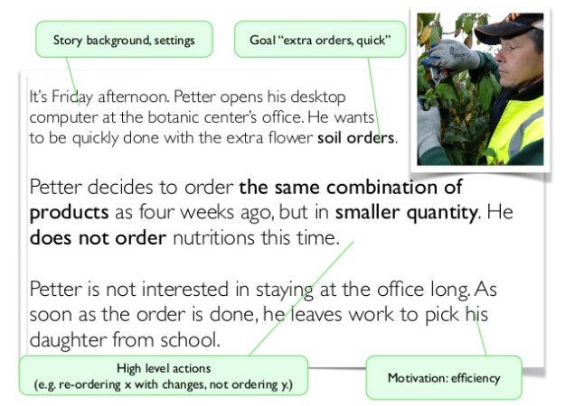

Slide 29
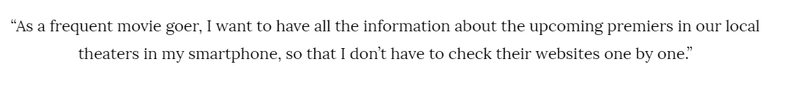
User story
Notes:
– they are short, but descriptive. User stories do not capture every detail about the user, her background, her ideas and motivations. Instead, they give an immediate understanding of what we are trying to accomplish with our product.

